Slide 1
RITA/BTS International Data Improvements
Steven Beningo
International Transportation Specialist
USDOT/RITA/BTS
Telephone Presentation to the
Texas Border Partnership Working Group
September 7, 2006

Slide 2

Presentation Overview
Data Uses and Customers
Border Crossing Data
Transborder Freight Data
International Trade Data System
International Freight Data Workshop

Slide 3
RITA/BTS International Data Uses
Tracking international trade and travel trends
Freight corridor planning
Border security and safety studies
Analyses of border congestion and system capacity at key international gateways for trade and travel
Analyses of changing patterns in international freight and passenger movements

Slide 4
RITA/BTS International Data Customers
Congress
FHWA
  To apportion funds under the Consolidated Border Infrastructure Program
Other Federal Agencies (DHS, Commerce, etc.)
State DOTs and local planning organizations
Academia
Media
General Public

Slide 5
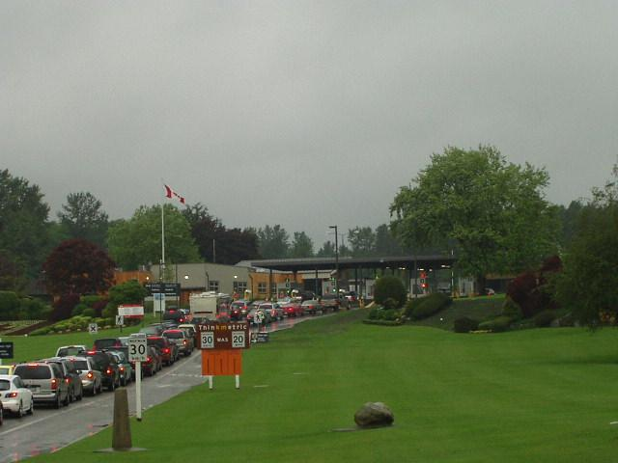
Border Crossing Data
Count of inbound border crossings
Collected by Customs and Border Protection
Available monthly from January 1995 onward
Data on:
  Vehicles
  Passengers
  Containers
  Pedestrians

Slide 6
Border Crossing Data Improvements
Previously, disseminated by e-mail in Excel spreadsheets
Now available in a new online searchable database: www.bts.gov/itt
  Users can search and download all historical data by:
    State
    Port
    Mode
    Year
    Month

Slide 7
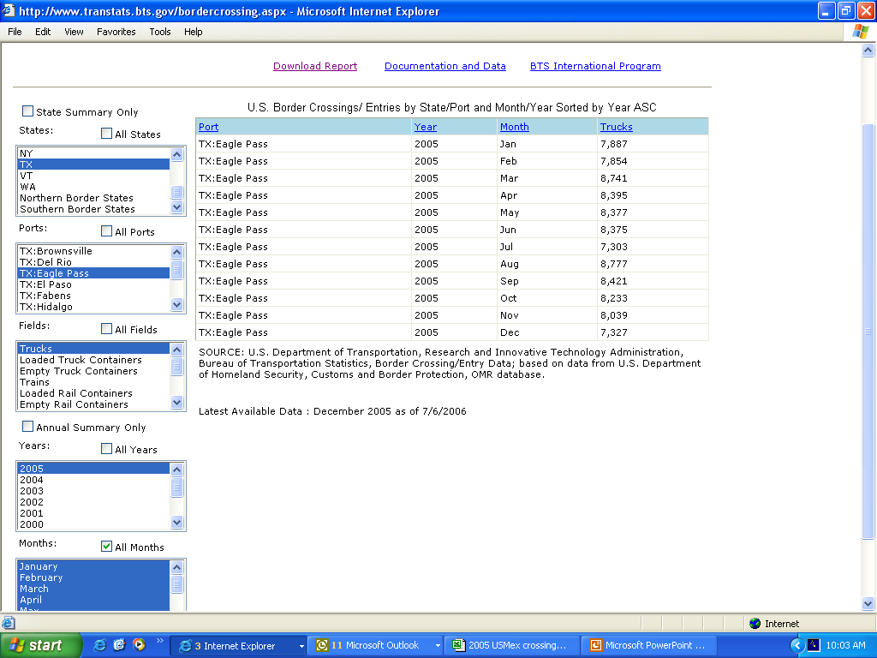

Slide 8
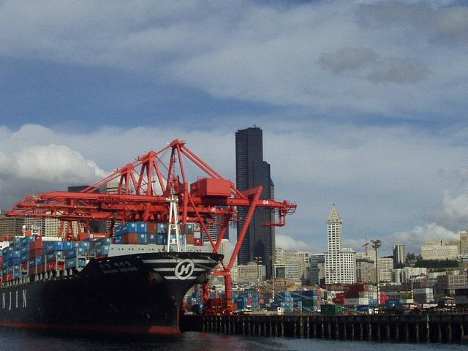
Transborder Freight Data
Exclusive source for data on U.S. freight movements with Canada and Mexico by ALL modes of transportation
Special extract of official U.S. Trade Statistics
Data available monthly from April 1994 onwards: www.bts.gov/itt
Data on NAFTA trade by:
  Value
  Weight
  Mode
  Commodity (two-digit HS)
  Port of entry/exit
  State/Province of origin
  and destination

Slide 9
Transborder Freight Data Improvements
Addition of Air and Vessel mode data in 2004
  Previously only land modes
Enhanced export weight estimation process
  Land modes (see handout)
Monthly press release
Critical gaps filled beginning with 2007 statistics
  New data structure linking port and commodity detail
  Weight data on exports to Mexico for all modes

Slide 10
Searchable Database Modernization Underway:
Target Completion – Spring 2007
Transborder Freight Data Improvements
Selectable Data Elements:
  Location
    U.S. State
    Port of Entry
  Trading Partner
  Year
  Month
  Mode
  Commodities
  Measure
    Value
    Weight
  Imports, Exports or Total Trade
  Percent Computation
  Sorting
  Description of Elements

Slide 11
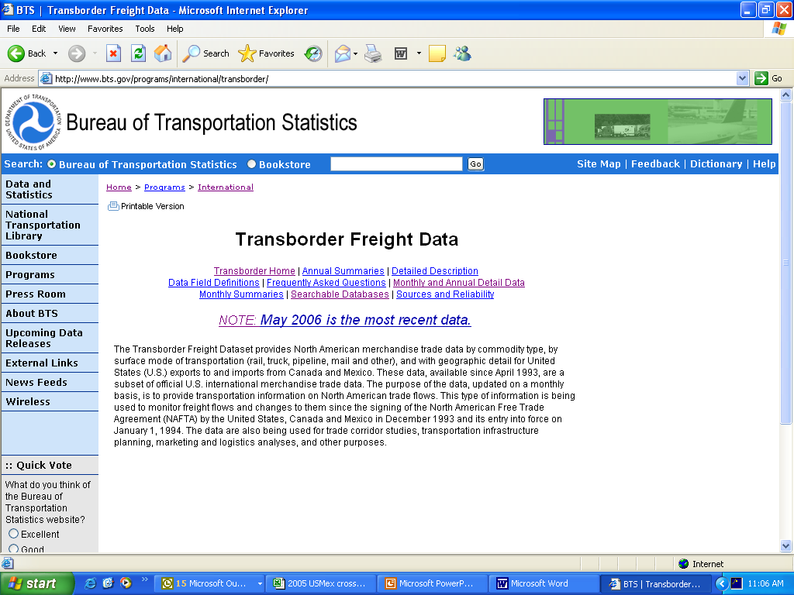

Slide 12
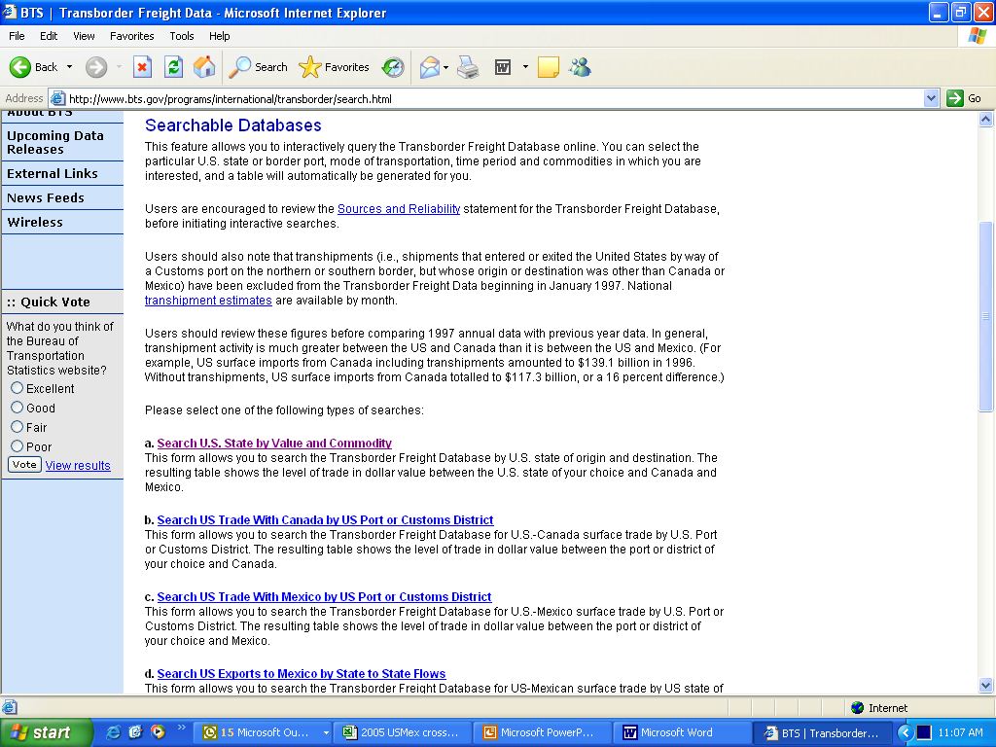

Slide 13
International Trade Data System
Project led by Customs and Border Protection
System will provide a single interface for international trade transaction filing
  Reduces burden on trade community
  Provides more accurate, timely, thorough data to federal agencies
Full implementation expected 2010

Slide 14
RITA/BTS Role in ITDS
RITA will be the lead agency for the development of a DOT-wide data portal
BTS will use data obtained through ITDS to create a comprehensive International Freight Transportation Data Warehouse
  This will include transportation data elements not currently available, such as:
    Multi-modal manifest
    Hazmat specific data

Slide 15
International Freight Data Workshop
Planned for Spring or Summer 2007
Goals:
  Inform participants of recent improvements to our data and solicit feedback
  Demonstrate uses and capabilities of our data
  Foster exchange between users and agency staff
  Identify new uses and demands for international freight data

Slide 16
Questions?
Steven Beningo
International Transportation Specialist
Bureau of Transportation Statistics
Research and Innovative Technology Administration
U.S. Department of Transportation
(202) 366-9683
steven.beningo@dot.gov

